Slide 1
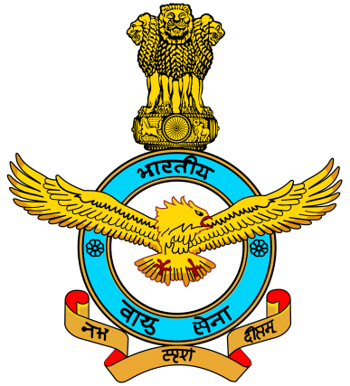

ACTIVITIES OF AIR NCC CADET
DURGA MAHAVIDYALAYA, RAIPUR
YEAR 2022-23

Slide 2
OUR STRENGTH
Year | Senior Division(SD)[BOYS] | Senior Wing(SW)[GIRLS]
3rd year | 20 | 02
2nd year | 23 | 13
1st year | 29 | 13
TOTAL | 72 | 28
Total Cadets: 100
Total 12 SWs and 10 SDs from other colleges were also enrolled in this session

Slide 3
ACHIEVEMENTS OF OUR CADETS

Slide 4
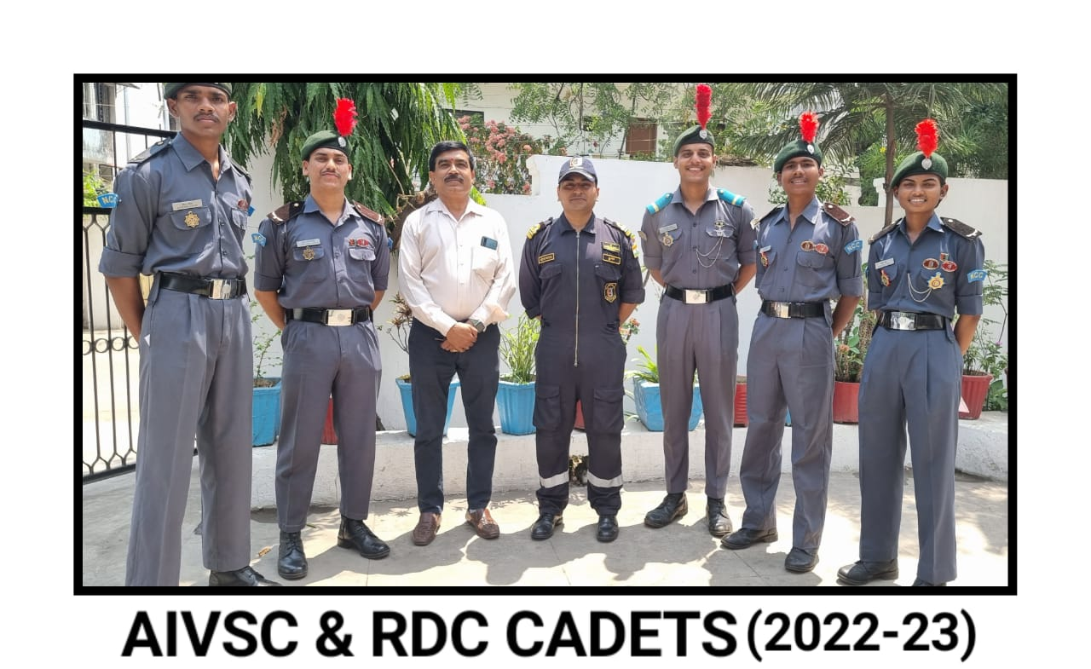
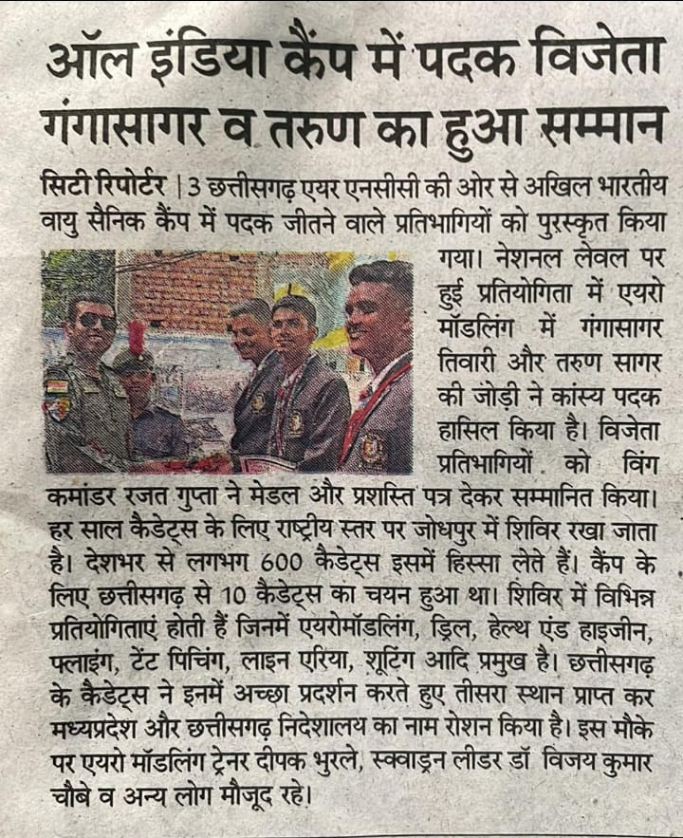
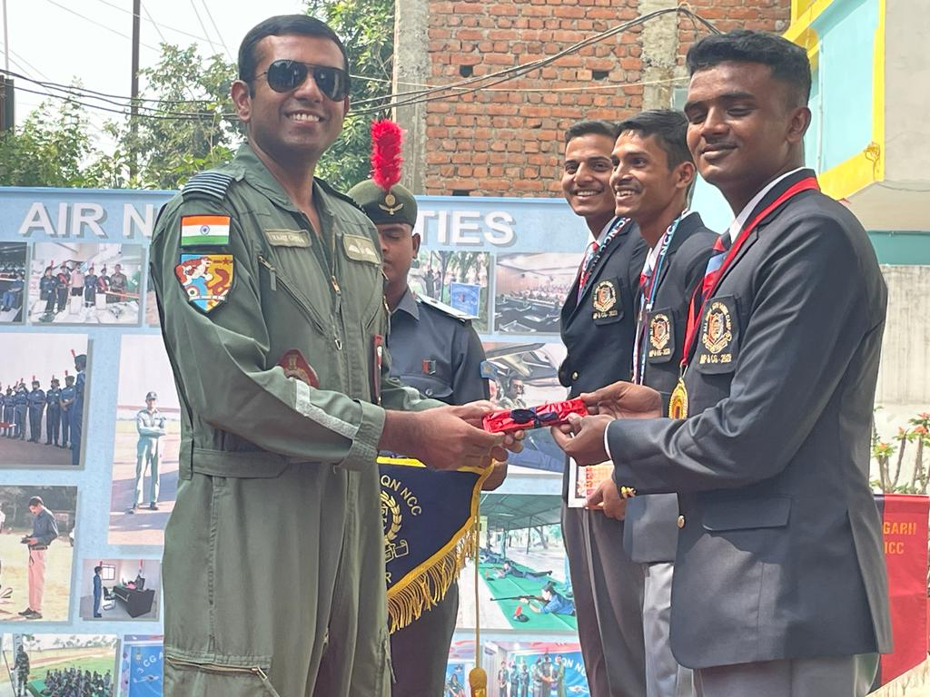
Cadets Attended All India Vayu Sainik Camp held at Jodhpur

Slide 5
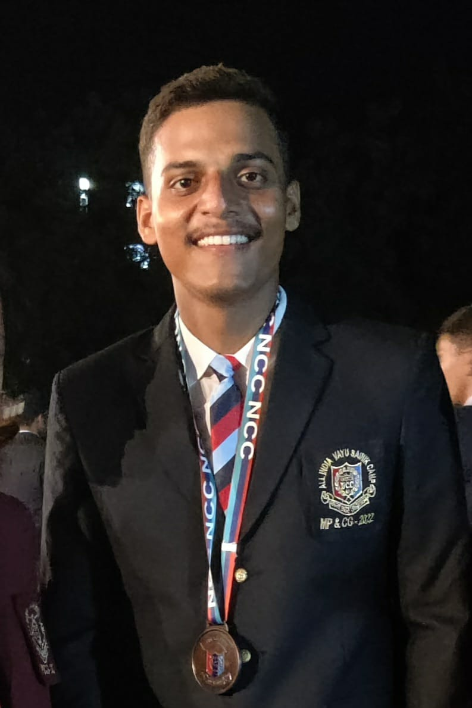
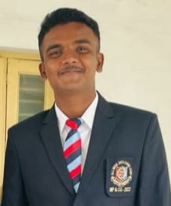
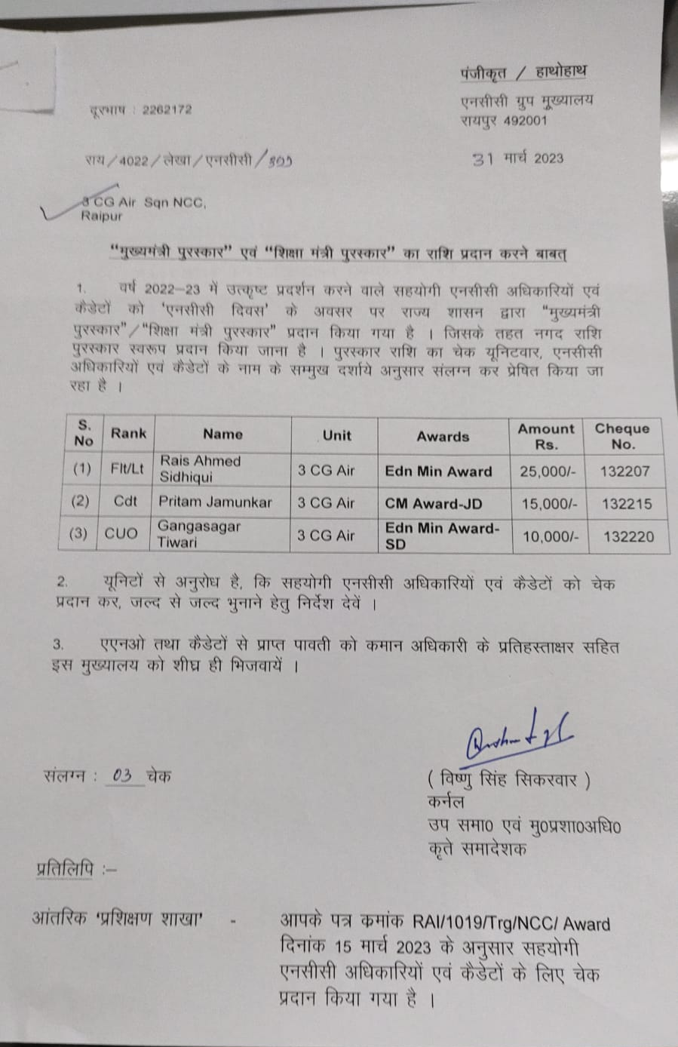
Cadets took part in AIVSC, Jodhpur
CUO Ganga Sagar Tiwari
CWO Sheikh Md Imraj
CUO Ganga Sagar Tiwari Won Bronze Medal in Aeromodelling at All India Level

Slide 6
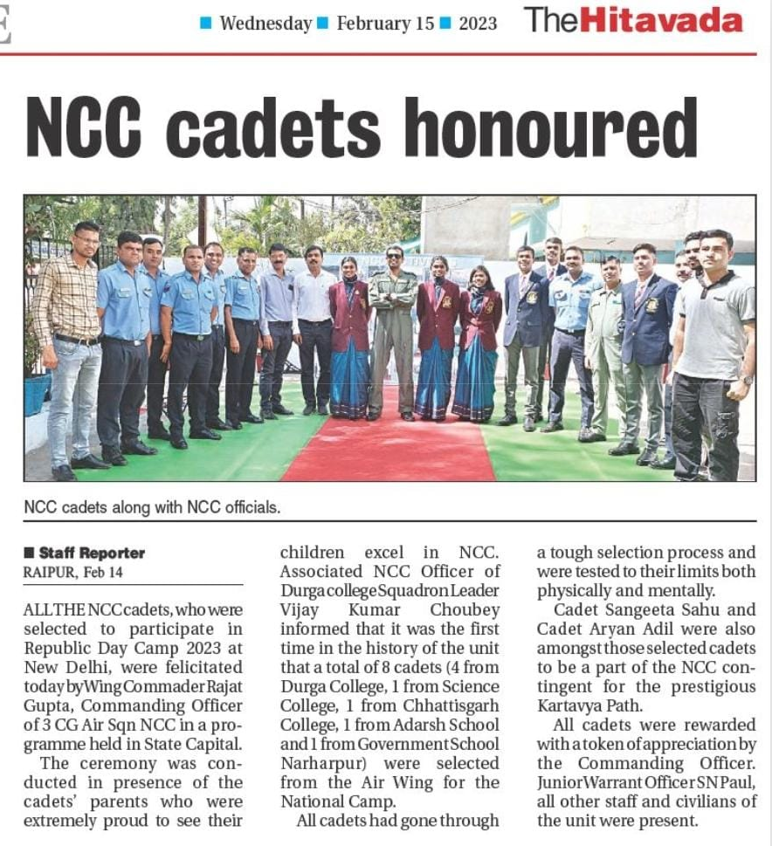
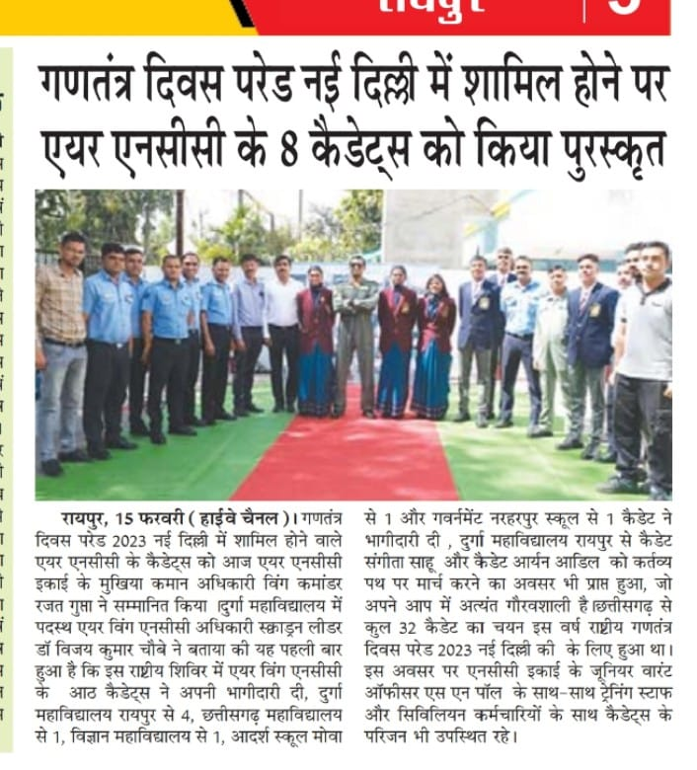
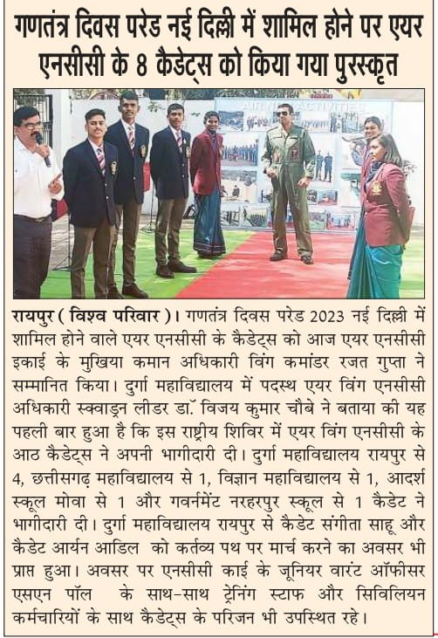
Cadets were honoured for taking part in Republic Day Camp-2023 held in New Delhi

Slide 7
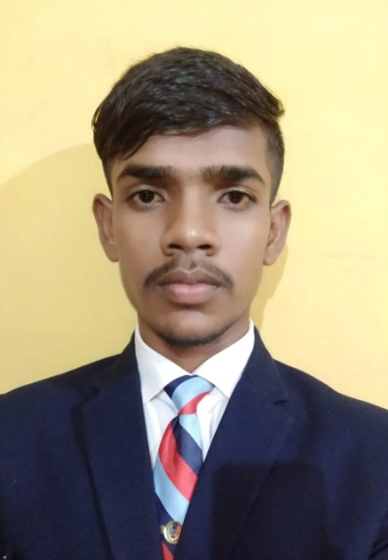
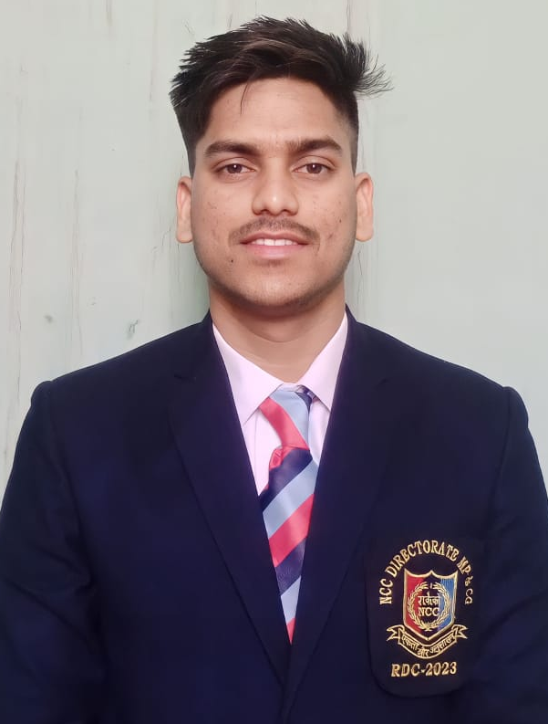
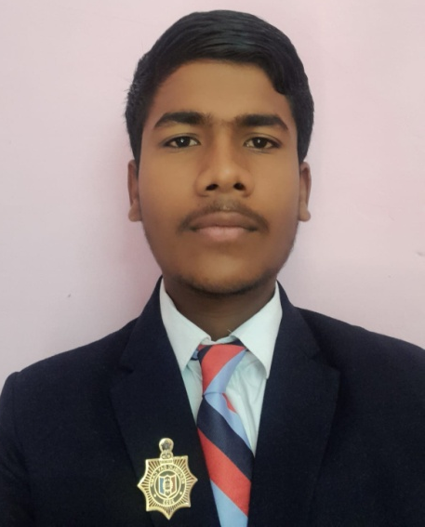
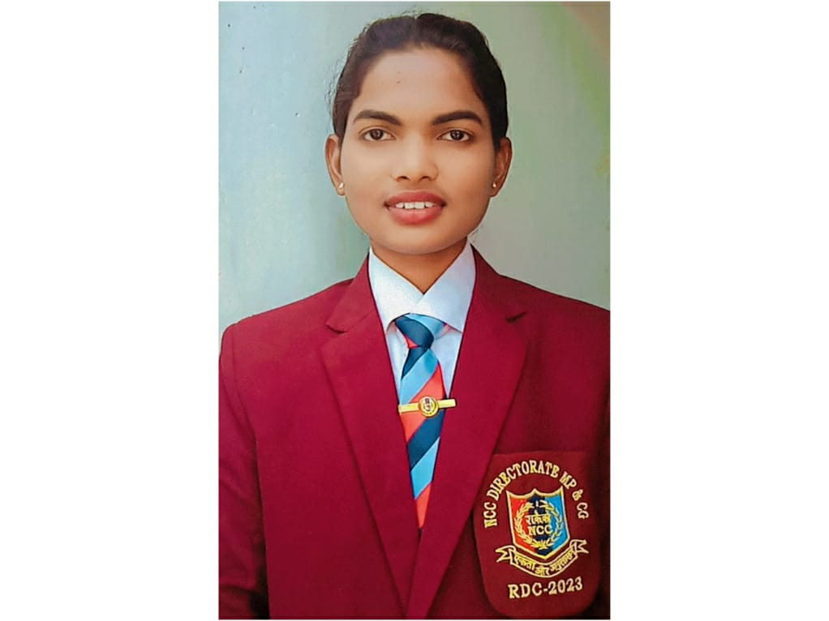
Following Cadets took part in RDC-23, New Delhi
Cdt Sourav Nayak
Cdt Taman Patela
Cdt Aryan Adil
Cdt Sangeeta Sahu

Slide 8
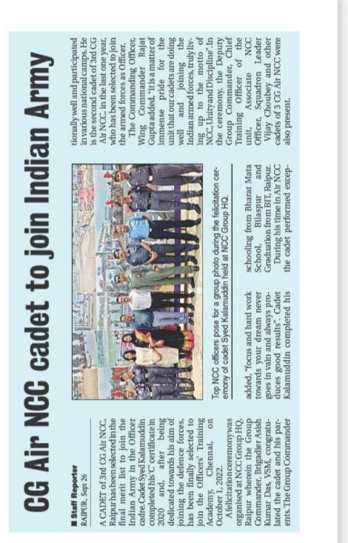
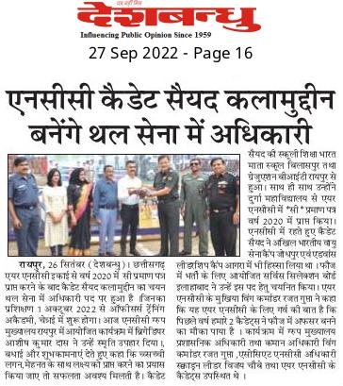
Cdt Sayeed Kalamuddin got selected in Indian Army as an Officer

Slide 9
OTHER ACTIVITIES

Slide 10
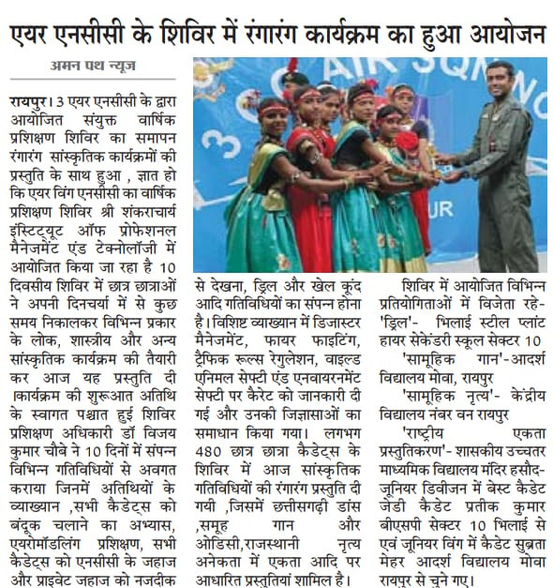
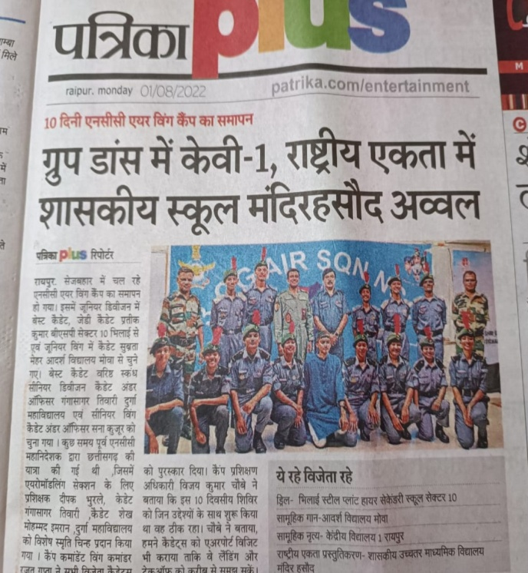
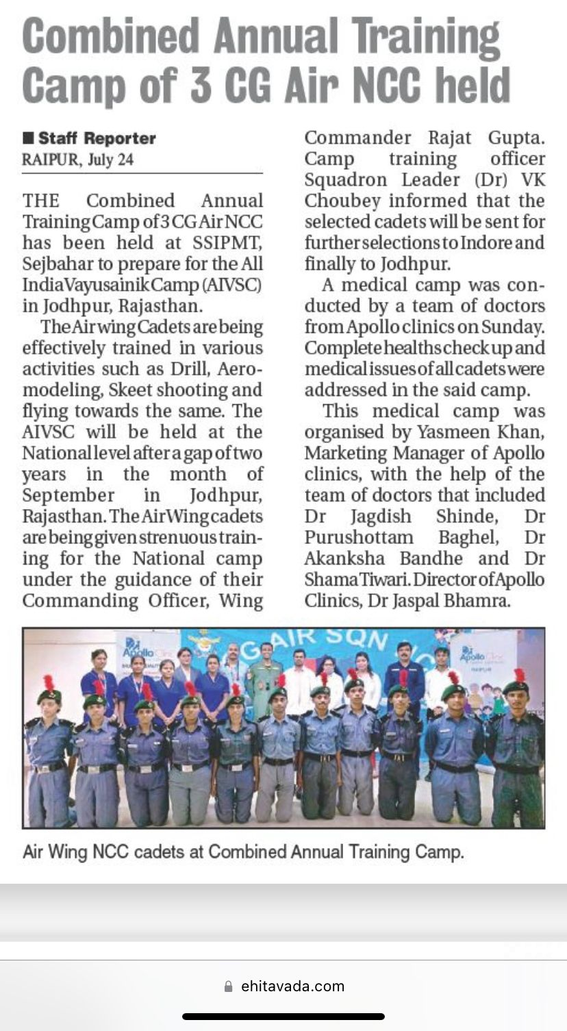
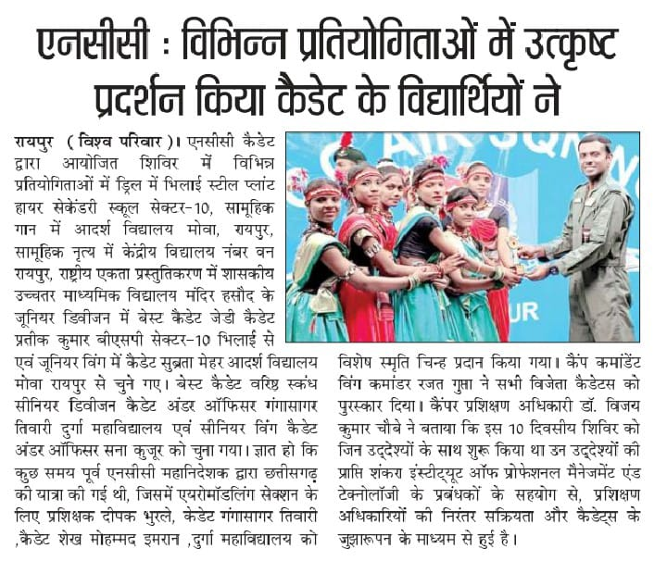
Combined Annual Training Camp
From 20 July 2022 to 29 July 2022

Slide 11
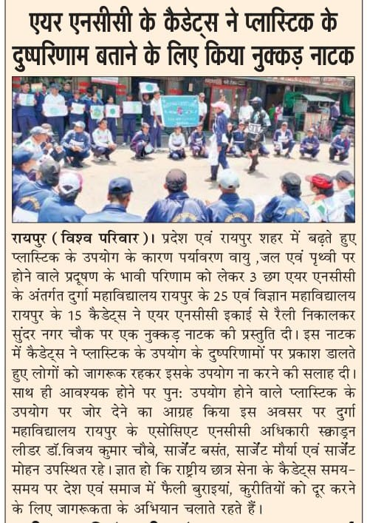
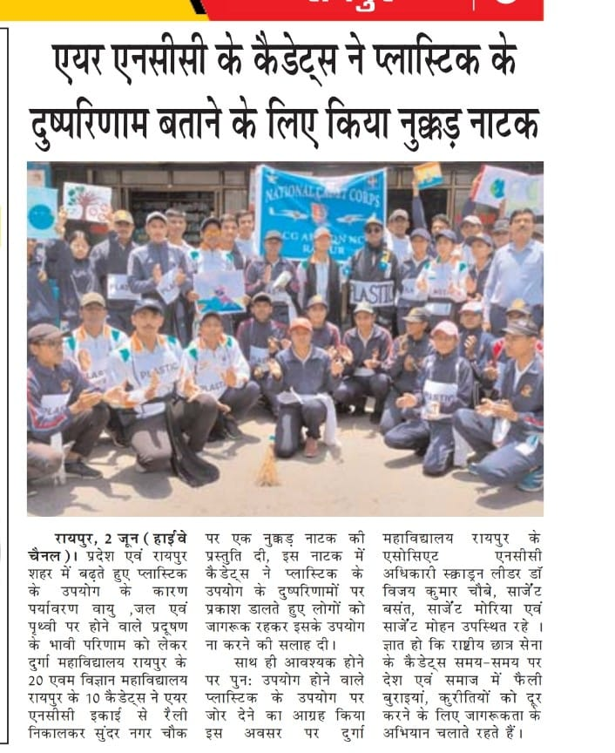
Cadets Performed Nukkad Natak on 2nd June 2023 to spread awareness about disadvantages of using Plastic. 25 Cadets participated

Slide 12
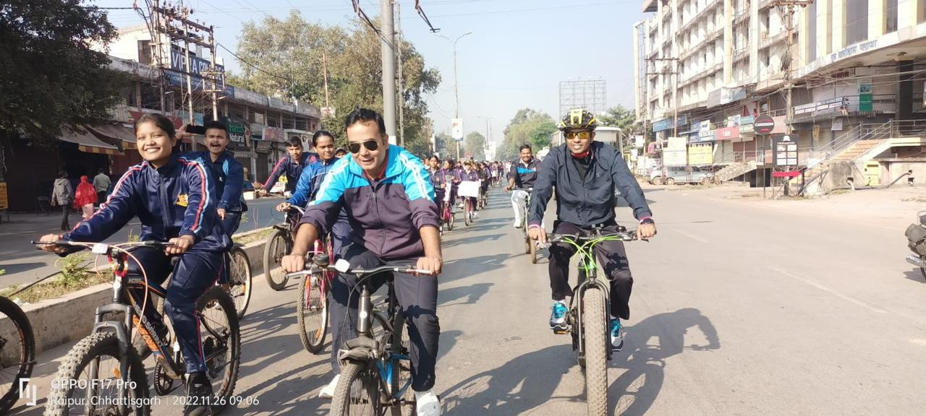
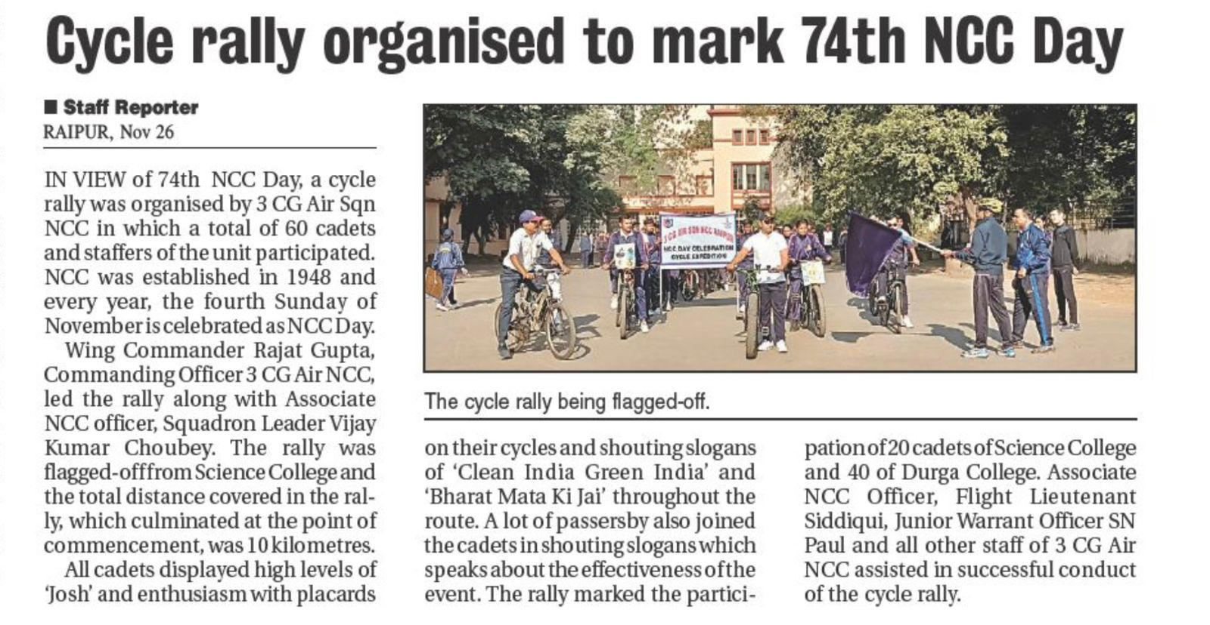
Cycle Rally to Mark 74th NCC Day

Slide 13
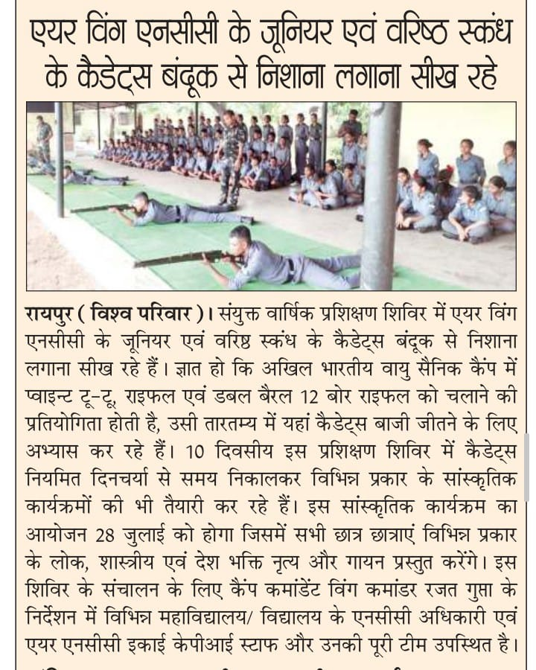
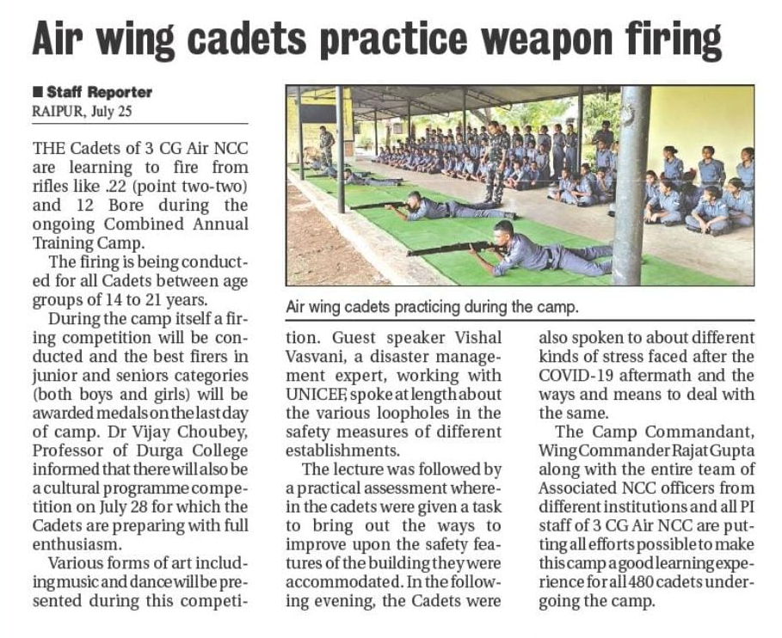
Cadets Handling .22mm Rifle

Slide 14
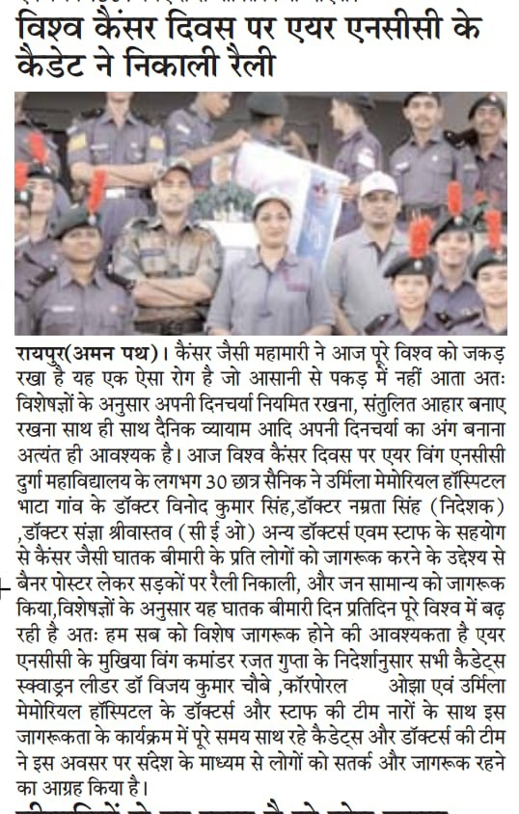
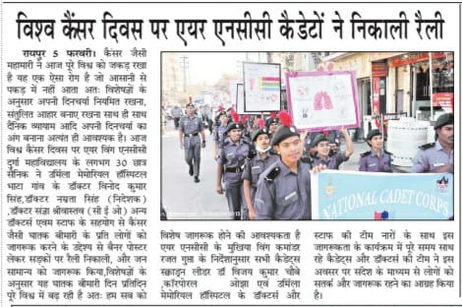
Rally By Cadets on the occasion of World Cancer Day on 4th Feb, 2023
30 Cdts participated from Durga College

Slide 15
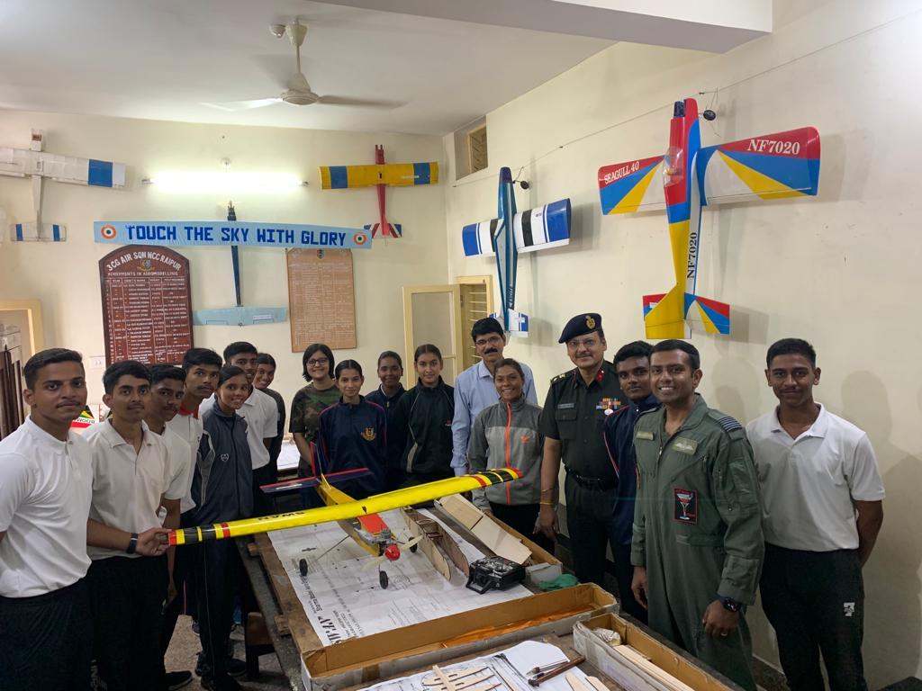
Cadets Practicing Aeromodelling

Slide 16
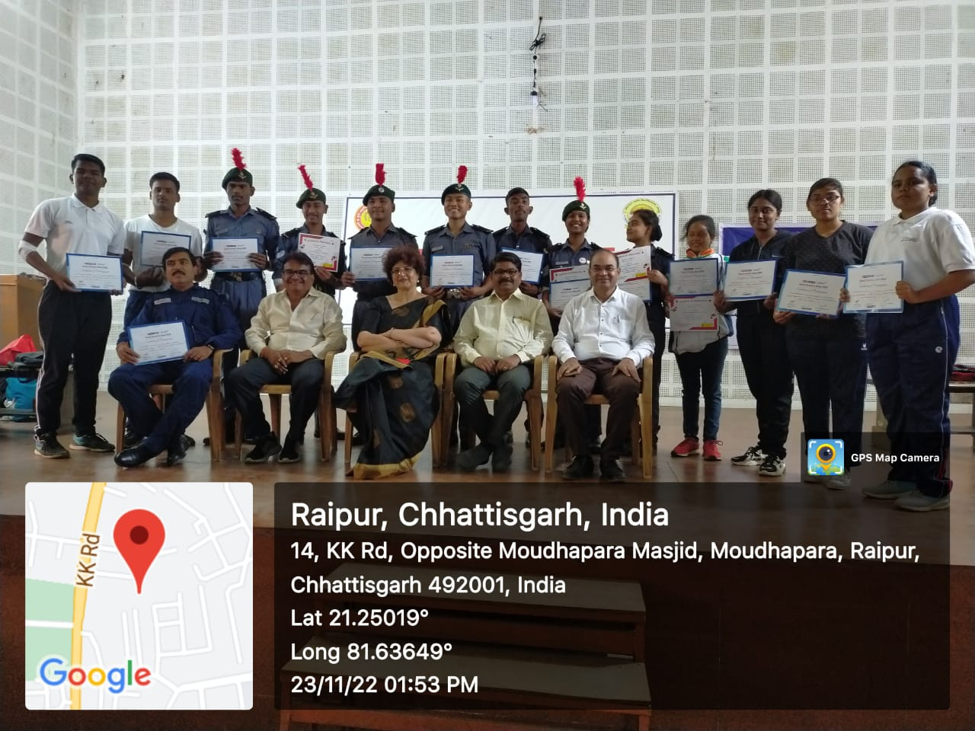
Blood Donation By Cadets

